Slide 1
Consolidating the Preservation, Description, Discovery, and Access of Digital Archives
CHRIS PROM (@chrisprom)
KYLE RIMKUS
BETHANY ANDERSON
UNIVERSITY OF ILLINOIS AT URBANA-CHAMPAIGN
PRESENTED 14 AUGUST AT THE SAA RESEARCH FORUM, WASHINGTON, DC
Notes:
Express
Apologies Chris couldn’t be here
The reason we wanted to present: interest expressed in the call for proposals in « use of IIIF by archives. »
We have spent the past year building a local preservation and access service for digital records in our university archives, in which IIIF plays an important part.
We’d like to get your thoughts on what we’re doing, especially since archives are different from libraries (in particular a different paradigm for metadata description and patron access).
These differences are reflected in the service we’ve built—in fact are central to it.

Slide 2
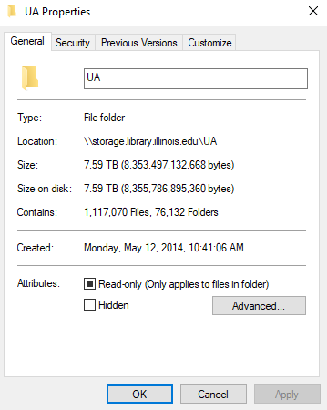
The Problems
Digital backlogs (to accession, to process, to publish)
Demand / resource mismatch
Notes:
Current Digital in ‘unprocessed’ folder: 7.54 TB & 1,113,695 files in 62 accessions.
Currently in preservation repository: 221 collections; 26.2 TB, 1,959,312 files. Of that, 42 collections accessible to the public
It’s like the 2018 variation of the ‘in a box’ problem that Ben Goldman raised -> how do we manage acquisitions, arrangement, description, and access at scale, for disparate records

Slide 3
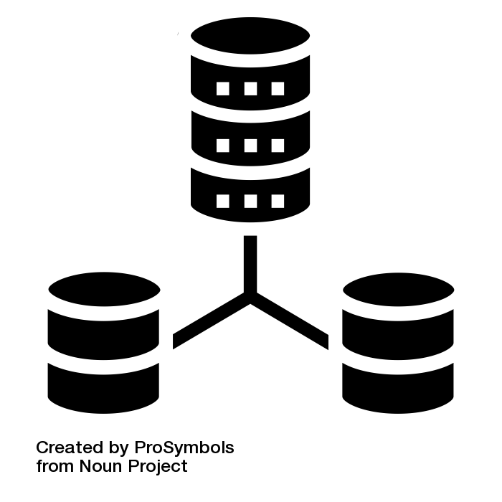
Redundancies and Inefficiencies
Descriptive System
Digital object MD
Resource MD
Pres.
System
Access
System
Notes:
Complicating potential answers to that questions is dispersion and duplication across different pots that we use to manage digital content and metadata.
Key takeaway from conversations I’ve had teaching Arrangement and Description of Digital Records
Sometimes, there is duplicate metatdata even within systems.
Adapting metadata models for pre digital age to digital
Digital object metadata often duplicates that in descriptive management systems
Descriptive tools are based on standards (they drive data model) rather than user needs or the nature of records
Access systems often based on library approaches to metadata (item level)

Slide 4
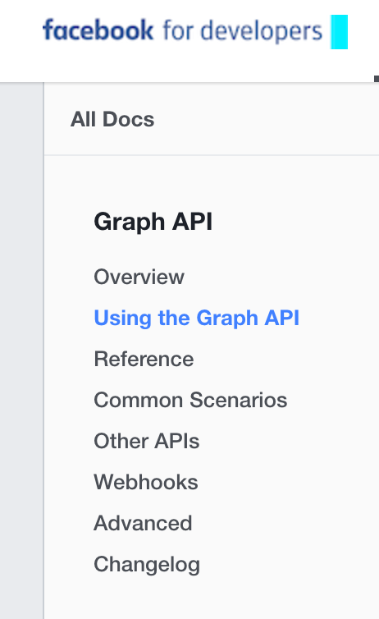
Notes:
At same time, there is a whole class of records we are barely acquiring.
“Archeology of Trumpism” blog post by Josh Marshall. . . . most ‘from the desk of Donald Trump’ videos taken down.
We are living in an API world . . .
Services, such as Google Drive’s API or that for Microsoft or twitter, provide methods to read data from the application. Not all of the data, but enough to make it easy to exchange information with the services.
BUT THE BIG QUESTION FOR ARCHIVES IS, HOW DO WE BEGIN ACUiRING THIS STUFF, AND ONCE WE HAVE IT, WHAT DO WE DO WITH IT, given our ‘old world’ system structures.

Slide 5
Archival Connections Project
evaluate, test, and implement methods that facilitate essential tasks of acquiring, arranging, describing, and providing access to born-digital materials
foster collaborative research to inform the design and implementation of emergent tools
increase collaboration and sharing between external standards groups and technology development projects
Notes:
These were the three areas I wanted to build out, based on comparison of data models, user studies, etc. But then reality intervened, and I’ve been involved in three projects which informed the system design.

Slide 6
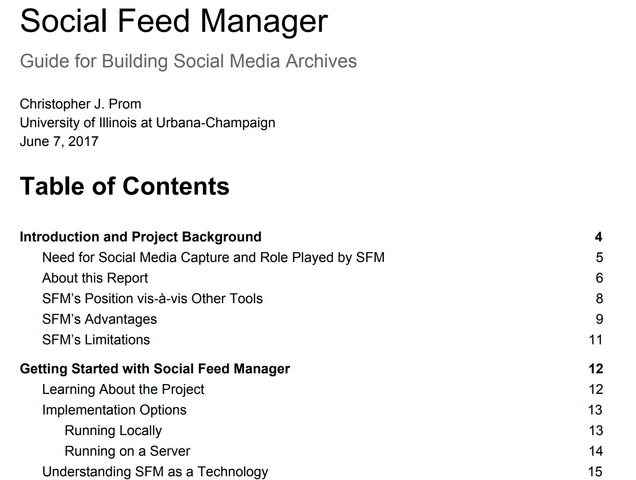
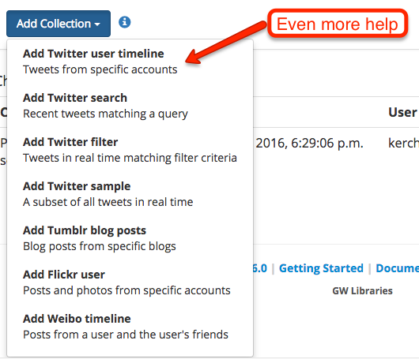
https://gwu-libraries.github.io/sfm-ui/resources
/SFM ReportProm2017.pdf
Notes:
First: Social Media. Asked to write a guide to collecting social media records, to evaluate and make recommendations about SFM. You can find my full report at the URL below.
One big takeaway . . .
from my work is that API’s make it relatively easy to capture and preserve the essential information in which we are interested in, as archivists. While my interaction with the information provided by these API’s does not suggest any fundamental need to alter arrangement and descriptive practices, our awareness of them will help us make slight tweaks to our practice, then ensure that future users will have the best possible ability to use whatever an API supplies--as the record of some particular archival action to capture it.

Slide 7
Aggregation
(Still)
Matters
Notes:
There is one big implication I took away from my time working with SFM: Aggregate Description Still Works and is perhaps more necessary than ever. . .
API’s make it relatively easy to capture and preserve the essential information in which we are interested in, as archivists. While my interaction with the information provided by these API’s does not suggest any fundamental need to alter arrangement and descriptive practices, our awareness of them will help us make slight tweaks to our practice, then ensure that future users will have the best possible ability to use whatever an API supplies--as the record of some particular archival action to capture it.
———
The dataset that SFM’s API supplies is entity that bears description by an archivist. This implies a reassertion of archival principles centering around the importance of collective description. What we have here is a new kind of aggregation, one in which the relationships may appear to be flattened in the responses sent by the API. For this reason, the archivist's role in trapping and fixing the records must be made much more explicit than it has traditionally been.
What is most important, and what we as archivists can do with those aggregations, is preserve the metadata and data supplied by the API, exactly as it is provided to us, because that is the form in which the descriptive and other metadata is most usable, for the most purposes.
{SKIP IF NECESSARY} After all, we do not have direct access to the ‘graphs’ or databases that underlie these technologies, but . . . most of the relatedness of API’s are expressed in file level metadata--which is embedded in the JSON response as a reference to some other ‘node’ or thing. Trying to relate it all after the fact in linked descriptive records would be very difficult but down the road possible, given the right set of technologies.
Therefore as interesting as the graph relationships might be at the file level, for now they continue to be more of a potentially useful technology for archivists than an ACTUALLY useful one. {END SKIP}
In the meantime, most of what we already need to describe records is available in existing descriptive standards, allowing some interesting repurposing down the road, perhaps even like the type of relational description models that Kat is going to describe next, provided that we preserve what that API’s supply us.
Thanks!

Slide 8
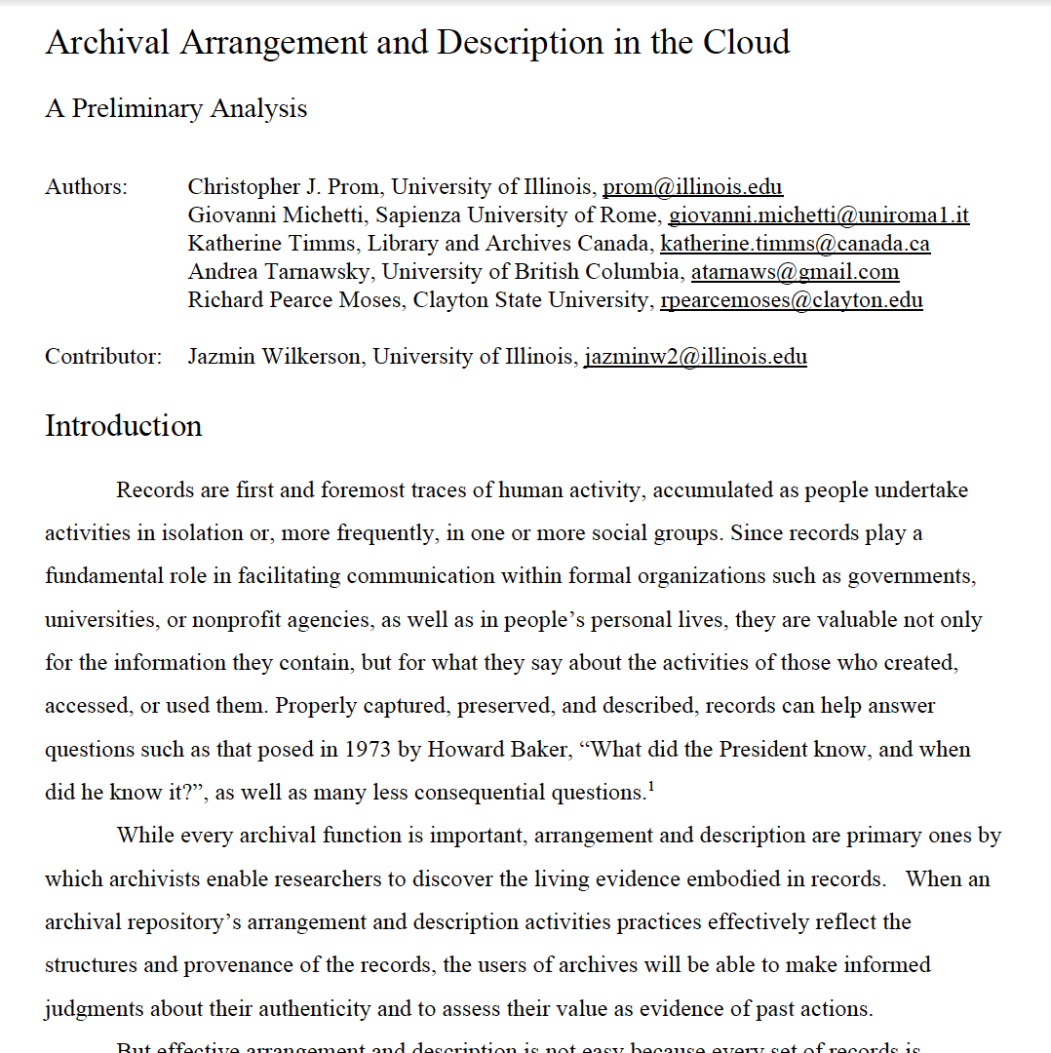
InterPARES Trust Project NA-22
Forthcoming Book Trusting Records in the Cloud (edited by L Duranti and C Rogers)
A&D in Cloud Paper:
goo.gl/mf2tJc
Notes:
Second Project: Study of requirements for arranging and describing records harvested from the clound--InterPARES trust paper, published in recent book by ArchiveSchule in Marburg Germany, but available in preprint.

Slide 9
System Design
Matters
(Specifically, flexibility in the underlying object model)
Notes:
Examined and mapped out data supplied by API’s for cloud services *such as twitter, gmail, google docs,
Each supplies own set of metadata, either for aggregations or for individual records.
Relatedness of the graph is flattened
cloud-based records appear as inherently problematic and mismatched to the underlying object-relational model of archival management systems, which are based on descriptive standards such as EAD. Yes, you can map them. But the process would be time consuming, a lot would be lost in translation, and it is unclear what would be gained from the user’s point of view.

Slide 10
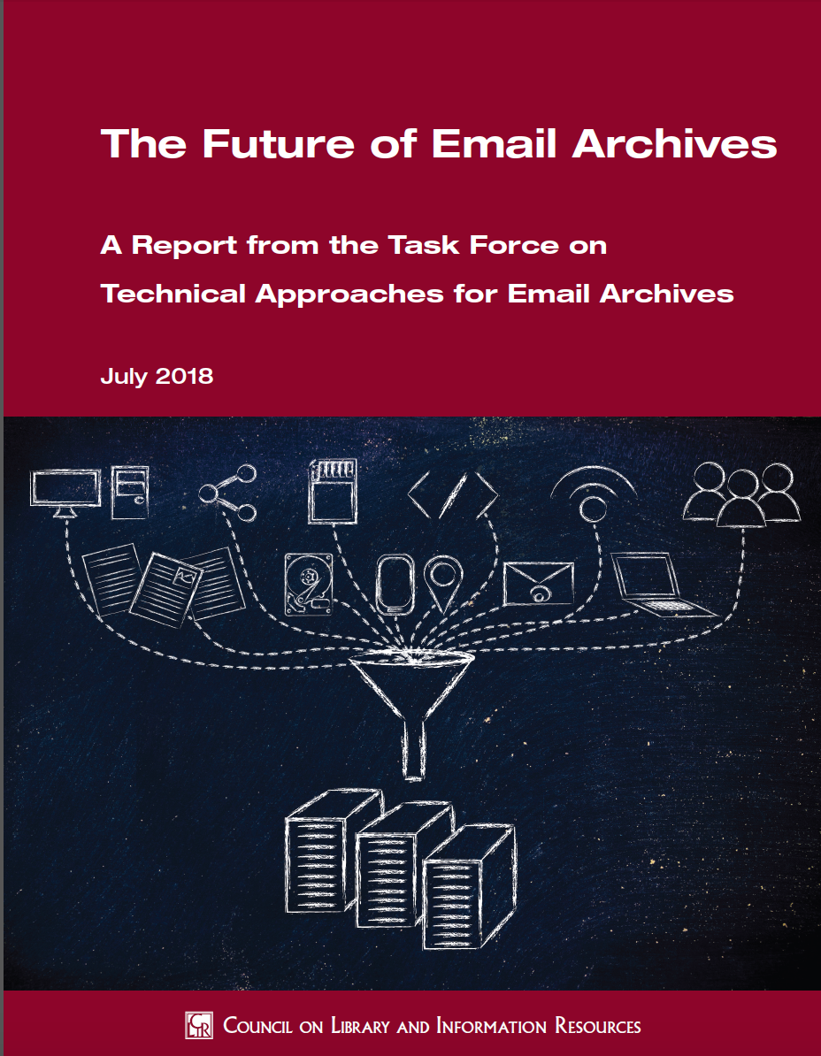
Task Force on Technical Approaches for Email Archives
www.clir.org/
pubs/reports/
pub175
Notes:
The third project into which I was pulled was the co-charing of a Task force on technical approaches to email archives. For which I’d like to put in a plug--the report was just published by CLIR and is available for download or purchase in hard copy here at the meeting.

Slide 11
Interoperability Matters
(But is it enough?)
Notes:
On big takeaway from that report is that the community of archives engaged in this topic could work much better if tools interoperated better.
Harmonization in data models
import and export
Tool chaining.
As a consensus recommendation, I support that. But I wonder if we don’t sell ourselves short, when we need to define complex workflows and tool chains to process, preserve, and provide access to what is already one of the most common and interoperable formats ever invented.

Slide 12
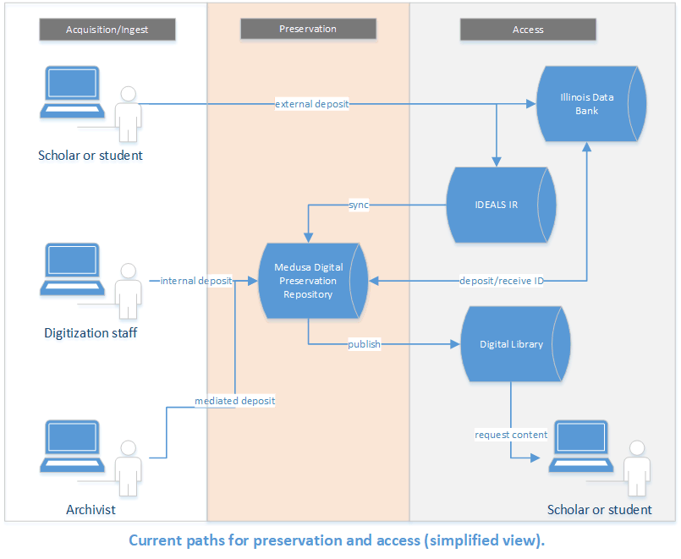
Integrated Services for:
> Acquisition
> Preservation
> Description
> Access
Notes:
Overall, these three themes (aggregation matters, design matters, and interoperability matters (but is not enough) are being brought to bear on the implementation ofa new digital preservation, description and access service at the University of Illinois: The Medusa Repository Service and its associated Digital Library

Slide 13
Underlying Philosophy
Archival description differs from library metadata practices but our collections will be more accessible when not tracked into ‘archives only’ services
Folder and file names contain enough metadata to orient the researcher digging through a collection of interest.
When forming the dissemination packet, we should be less bound by ‘original order’ than by user needs
Notes:
This was begun as a library systems but based by Kyle Rimus on some of the underlying philosophies we had previoulsy applied just to archival descritption.
We have a fairly automated process by which the archivist can deposit this into our digital preservation system, Medusa. Curators just need to give the collection a title and description in Medusa and an official description, and the ingest occurs quite quickly.

Slide 14
Aggregation Matters:
Digital Records File Package Structure
Files arranged for user access
Files for limited (e.g. building) access
Files for open online access
“Preservation documentation information” (manifests, donor corresp, logs, etc.)
Files before processing (archivist access only)
Notes:
Ways the specific conclusions impact system design: First aggregation matters.
We begin with a simple file package structure for managing our content.
1 collection = 1 packet.
Our archivists will work with our Digital Preservation Coordinator to transfer computer media from legacy formats to a staging area on shared network storage.
Largely inspired by some of the research Chris has done as part of a project a couple years back called Practical e-records, the original files go into a folder called “preservation.”
Ancillary reports or additional information goes into a folder called “pdi” or “preservation documentation information.”
Both of these folders preserve the original deposit and contextual information, before any arrangement of description is completed by the archivist.
The “Access” folder holds a representation of the files after that have been arranged and described by the archivist.
Processing includes both triage-- the removal of non-record materials, duplicate copies, and the like--as well as the reordering of content, when necessary, into logical groupings reflecting archival principles of original order.
Materials for building use only and restricted to our local IP range going into the “nearline” subfolder, while the “online” subfolder holds content that is open to the world.

Slide 15
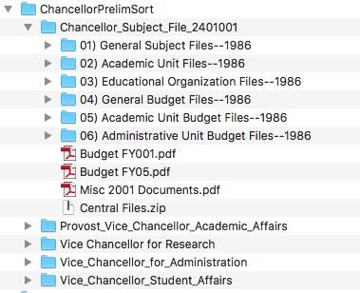
Sample Accession
16,895 items
18.26 GB
Notes:
This shows a sample accession about ⅔ of the way through processing.
Knowing that the filesystem metadata is itself a representation, and that by changing the folder and file titles, or moving content, the collection is being sorted into five separate records series, each representing the collecting or creating office.
This is one level of ‘provenance’ and we realize that other orders are possible.

Slide 16
Inferring Meaning from Context
Notes:
The goal here is to use as many clues from the folder and file names, and to rely as much as possible on embedded metadata, to give the researcher meaningful flags by which to orient themselves in the collection, and to make an informed analysis of it.
For archivists and the sort of primary-source researchers who regularly use archives, this makes great sense.
Based on understanding that files and folder metadata is itself a representation, many order possible
but this approach has not always gone over well with people who have been steeped in what we could call traditional library description, not only of one record per item, but of a sort of tightly controlled management of metadata terms and their application.
Culling descriptive metadata from image files and simply using it, no questions asked, flies in the face of what I’m calling the traditional, controlled approach
not to mention the concept of being comfortable making certain files accessible that have little descriptive metadata whatsoever.
What we’ve found is, the meaning of these files can be inferred from their context in a collection.
“Discovery” doesn’t need to be something where discovery isn’t possible—we can give researchers access to our collections in a way that allows them to actually discover things.
Researchers are smart—they don’t need to be spoon-fed everything.

Slide 17
Benefits
Archivists can spend most of our time preparing an archival packet that is arranged to meet user needs: That is, to arrange the files in a particular way, and to title the files and folders in a way to reflect those decisions.
The digital library system ‘reads’ and represents their decisions automatically, without the need to create a separate set of metadata in a finding aid or archival management system.
Notes:
In a very practical sense, this feature builds on a core archival assumption--that description follows arrangement.
This has three practical implications.
Archivists can spend most of their time preparing an archival packet that is arranged to meet user needs.
They can make decisions to arrange the files in a particular way, and to title the files and folders in a way to reflect those decisions.
The digital library system is able to ‘read’ and represent their decisions automatically, without the need to create a separate set of metadata in a finding aid or archival management system.

Slide 18
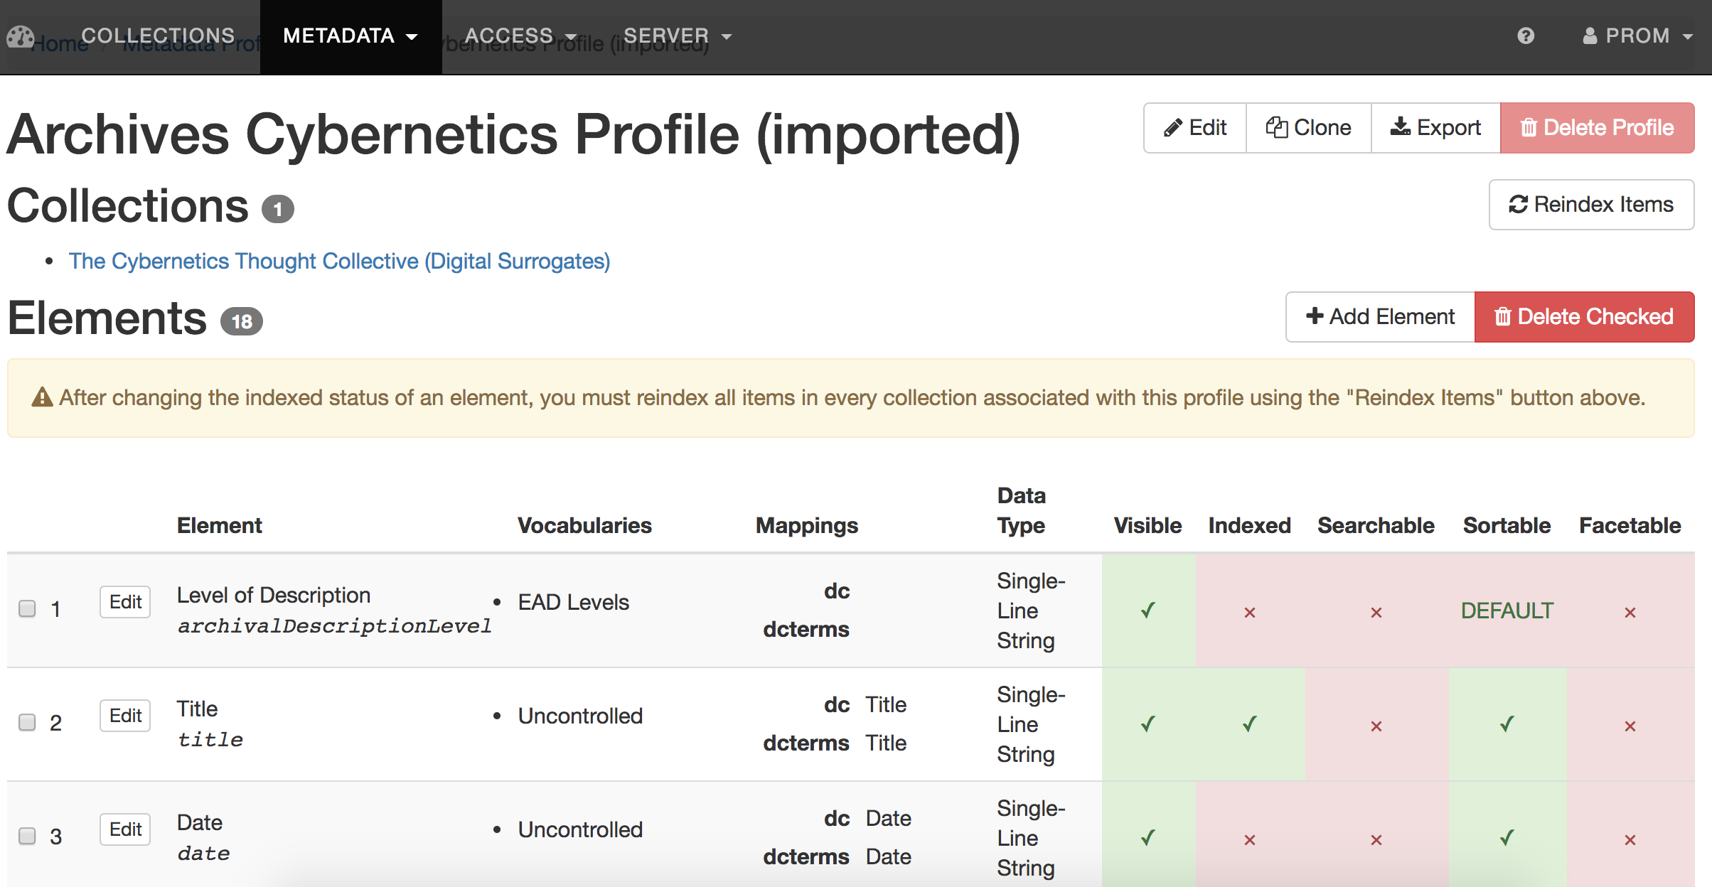
Design Matters:
Flexible Metadata Profiles and Ingest Routes
https://digital.library.illinois.edu
Notes:
Most collections use ‘archives general’ profile (DACS based) and can apply vocabularies to it. We can decide on a profile basis which elements are indexed, search able or facetable.
Since each element can be separately indexed, made facetable, etc on a profile basis, have fine grained control over how metadata is exposed to user. It is also included alongside other elements from other profiles, mapped to DC
And we can define new profiles on a case by case basis, where we need to extend beyond DACS or even don’t think certain DACS elements apply.

Slide 19
Extracting Embedded Metadata
Notes:
This also allows us to preserve metadata the already exists, in the format it is encoded, without doing any complicated mappings
For Example, with photography collections--the content creators have embedded considerable descriptive metadata in their files to aid their own local search and discovery of them.
Our system has a mechanism by which we can cull that XMP metadata from image files and store it for search and display.
For example, in a collection like this, the item-level descriptive metadata as generated by the creator--that is, the original photographer of this item--for image files will appear in the IIIF manifest for them.

Slide 20
Interoperability Matters:
Digital Records Viewer
Mimics folder/file browsing in a file system
Microservices display contents
IIIF Universal Viewer
javascript PDF viewer
HTML5 media player
A text viewer for plain text
Downloader for others (solo or in bulk)
Notes:
Finally, we are building tools which work seamlessly to display and make accessible whatever is uploaded. collapse distinction between descriptive database and digital object viewer.
The application uses microservices if you will to display different content types
IIIF for image file formats
A javascript PDF viewer for PDF files
An HTML5 media player for audio and video
A text viewer for plain text
And a downloader for files that don’t fall into any of those categories
(Incidentally, users are able to download at any level in the hierarchy they like—at the file, folder, or collection-level).
Our display mechanism allows end users to browse through digital folders much the way they would through physical boxes and folders in the archives, making discoveries as they go along.

Slide 21
Canteloupe IIIF Image Server
Developed by Alex Dolski
Java-based
Easy to implement
Great documentation
https://medusa-project.github.io/cantaloupe/
Notes:
Enthusiasm for what IIIF community has accomplished and our interest in learning more and engaging more with it
Got up and running with IIIF very quickly
Developer Alex Dolski built and maintains the Canteloupe image server
Basic Setup is fairly simple

Slide 22
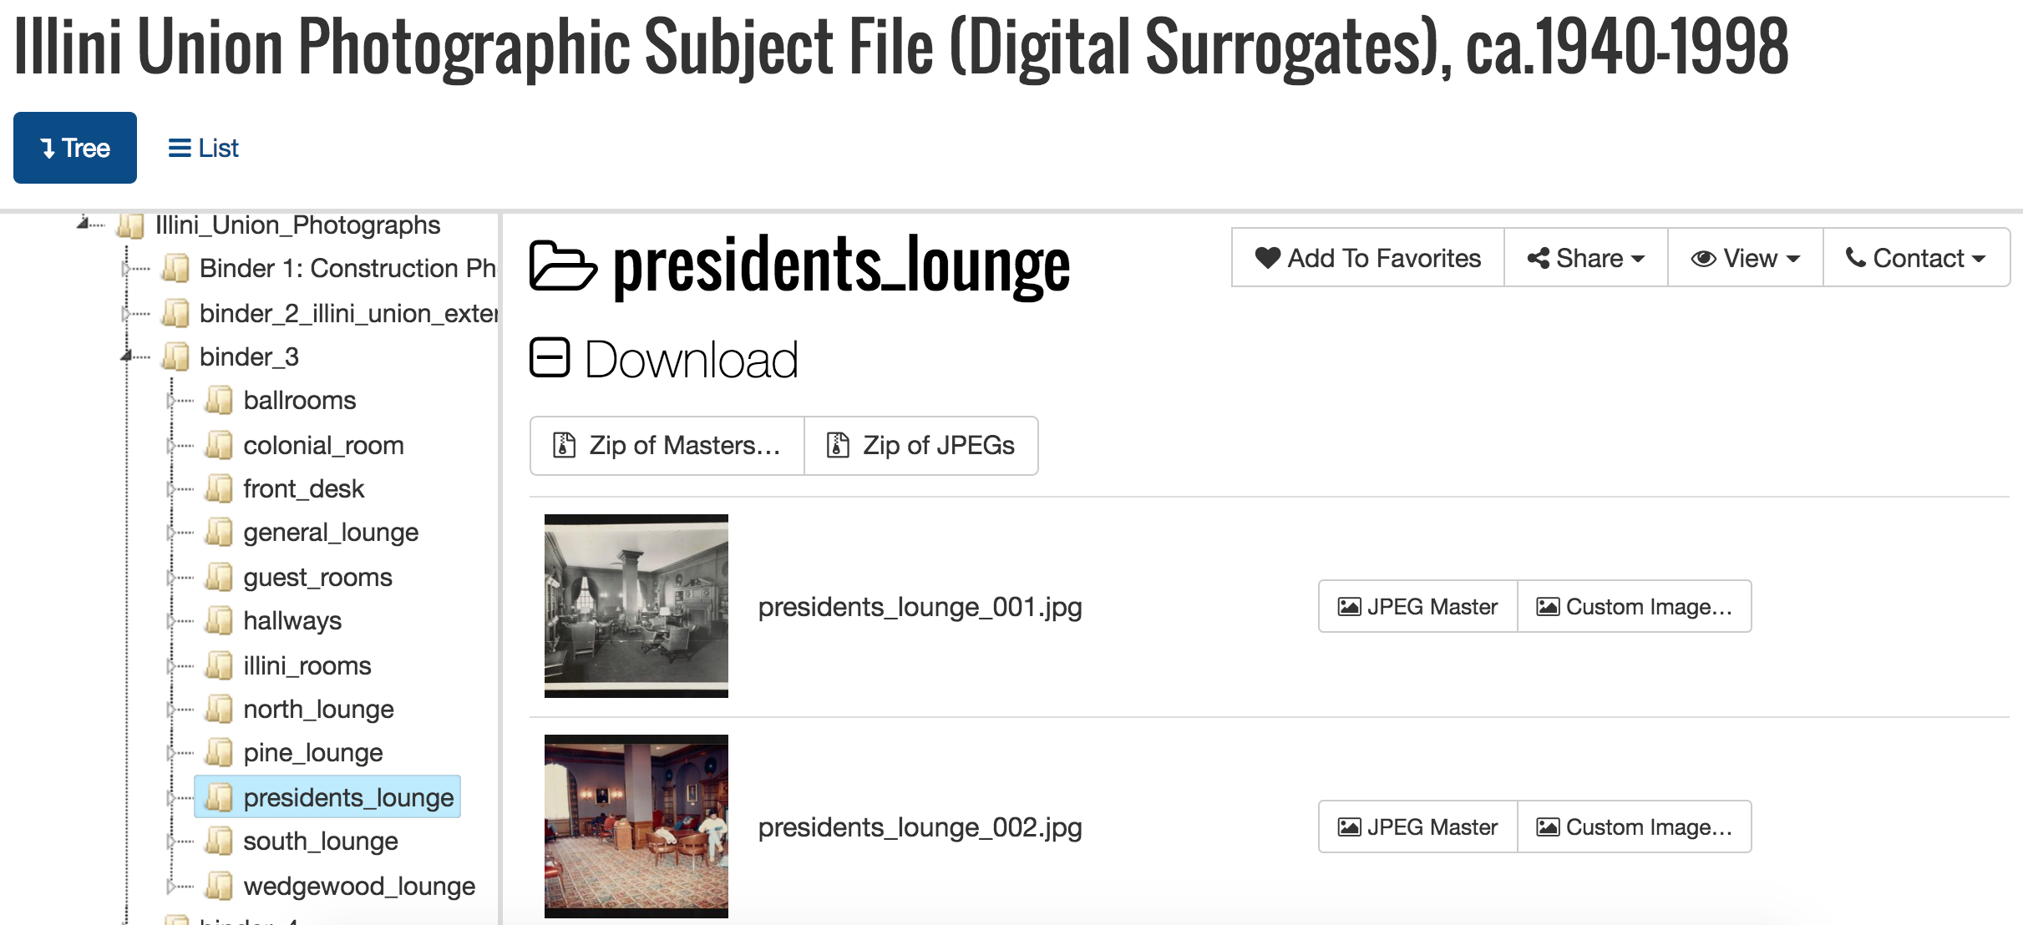
Navigating an image collection
Notes:
Play video, while pointing out
Folders and file names provide contextual metadata
With these tools in place, a collection of 3K images can be acquired and published to the web very swiftly

Slide 23
Oral History Materials
Notes:
Another example: Oral history projects are often technically complicated to implement, with many bells and whistles—this approach makes it simple. And the researcher can figure it out.

Slide 24
Future Directions
Push services into cloud (Amazon Web Services and Azure).
Investigating expanding digital viewer microservice to other formats
Experiment with machine learning to classify records (machine role would be made apparent)
Allow office and donor self-deposit, with review
Implement similar approach to description of non-digital materials (instead of finding aid or separate archival content management system)
Notes:
Look into whether IIIF microservice ought to be expanded to other formats or not
Investigate cloud machine learning

Slide 25
Contact
Christopher J. Prom
Email: prom [at] illinois [dot] edu
Kyle Rimkus
Email: rimkus [at] illinois [dot] edu
Bethany Anderson
Email: bganders [at] illinois [dot]edu
Thank you!
Digital Library Application (kumquat): https://github.com/medusa-project/kumquat
IIIF-Image-API-compliant image server (canteloupe): https://medusa-project.github.io/cantaloupe/

